Slide 1


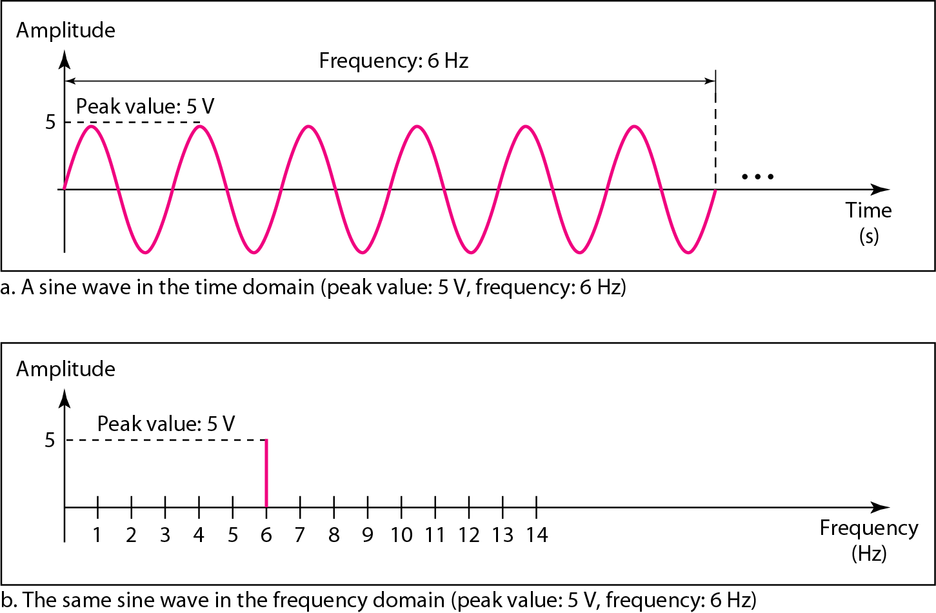
Figure The time-domain and frequency-domain plots of a sine wave

Slide 2
A complete sine wave in the time domain can be represented by:
One single spike in the frequency domain.

Slide 3
Example
The frequency domain is more compact and useful :
When dealing with more than one sine wave.

Slide 4
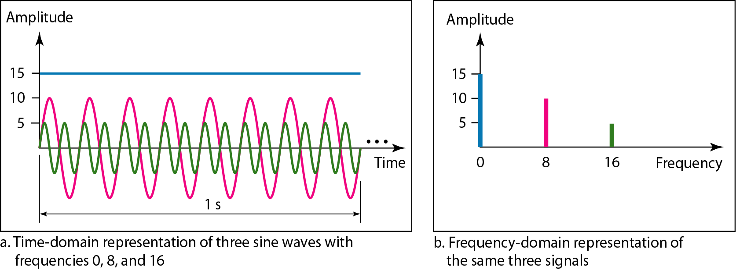
Figure The time domain and frequency domain of three sine waves

Slide 5
Single-frequency sine wave is not useful in:
Data communications.
Need to send a composite signal:
Signal made of many simple sine waves.

Slide 6
According to Fourier analysis, any composite signal:
Combination of simple sine waves.
Have different frequencies, amplitudes, and phases.

Slide 7
If the composite signal is periodic.
Decomposition gives a series of signals with discrete frequencies.
If the composite signal is nonperiodic.
Decomposition gives a combination of:
sine waves with continuous frequencies.

Slide 8
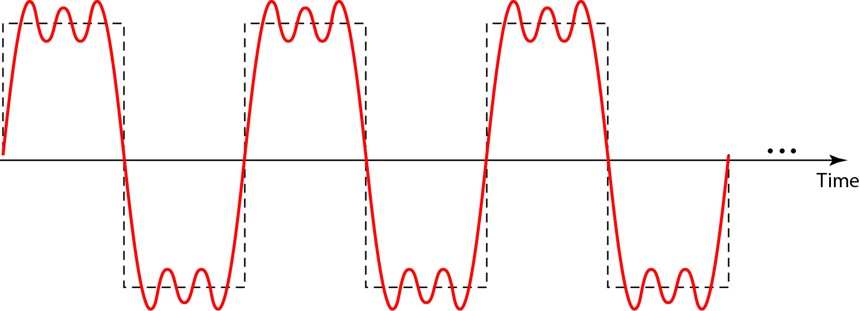
Figure A composite periodic signal

Slide 9
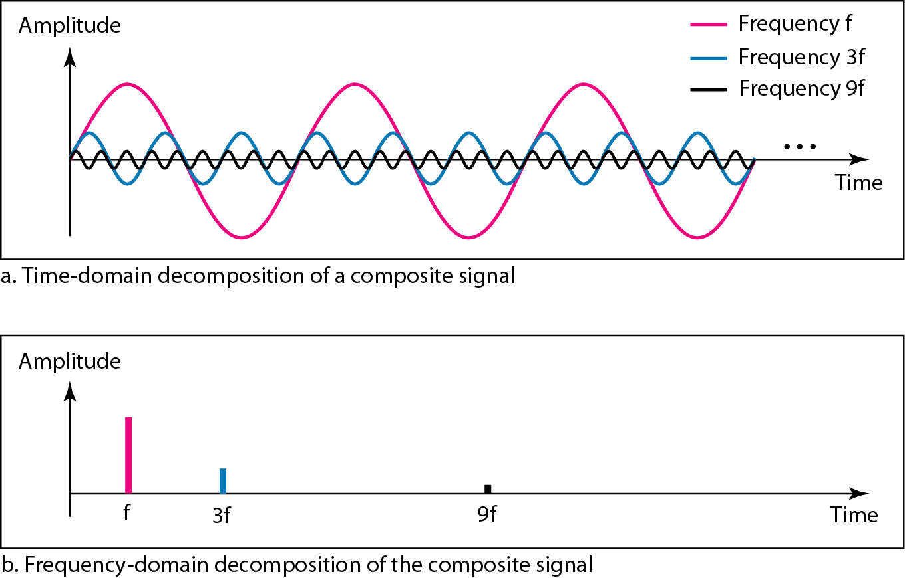
Figure Decomposition of a composite periodic signal in the time and frequency domains

Slide 10
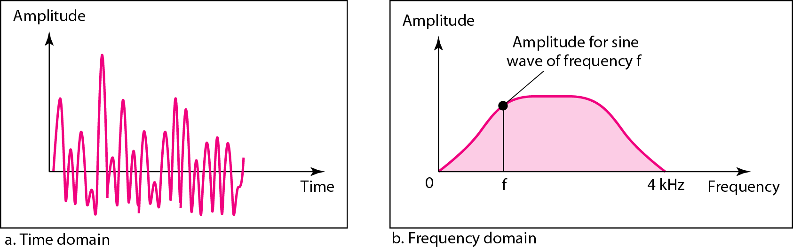
Figure The time and frequency domains of a nonperiodic signal

Slide 11
Bandwidth of a composite signal is the difference between:
Highest and the lowest frequencies

Slide 12
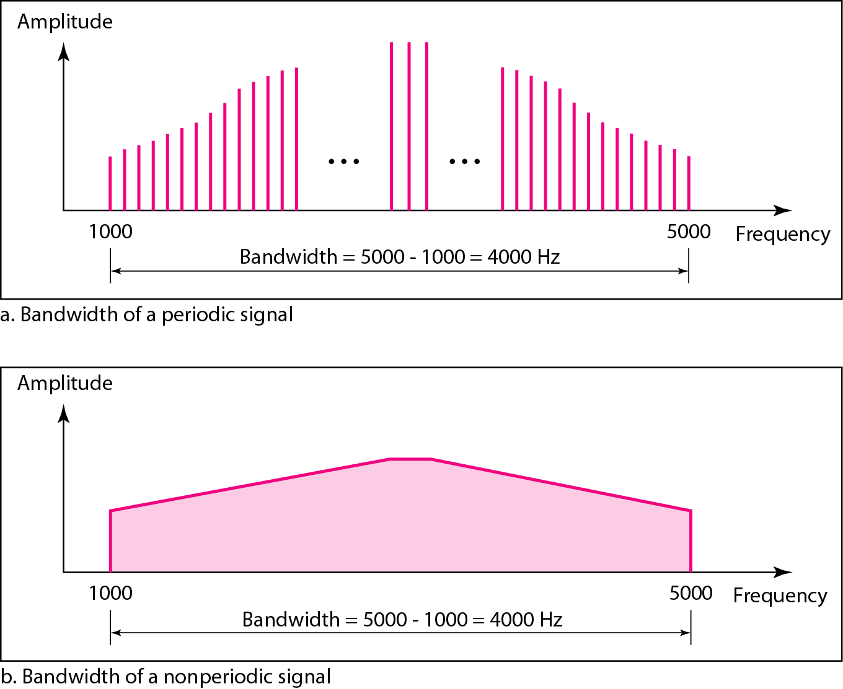
Figure The bandwidth of periodic and nonperiodic composite signals

Slide 13
Example
If a periodic signal is decomposed into five sine waves with frequencies
100, 300, 500, 700, and 900 Hz
What is its bandwidth?
Draw the spectrum, assuming all components have a maximum amplitude of 10 V.

Slide 15
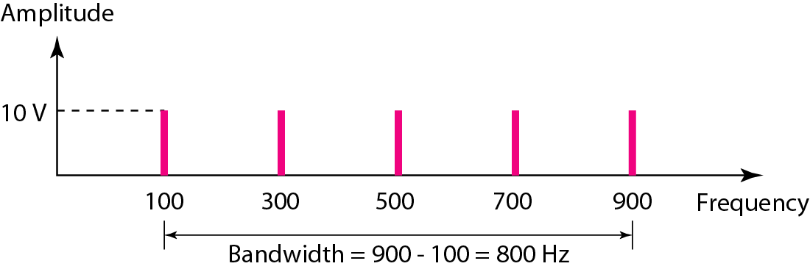
Figure The bandwidth for Example

Slide 16
A periodic signal has a bandwidth of 20 Hz.
The highest frequency is 60 Hz.
What is the lowest frequency?
60 Hz
20 HZ
40 Hz
80 Hz

Slide 17
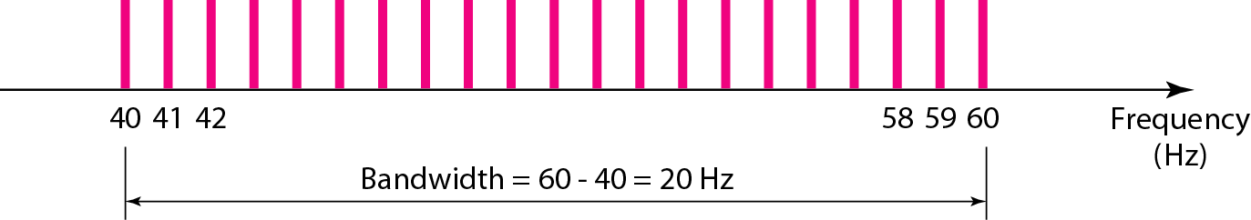
Draw the spectrum if the signal contains all frequencies of the same amplitude.

Slide 18
Example
A nonperiodic composite signal has a bandwidth of 200 kHz, with a middle frequency of 140 kHz and peak amplitude of 20 V. The two extreme frequencies have an amplitude of 0. Draw the frequency domain of the signal.

Slide 19
Solution
The lowest frequency must be at 40 kHz and the highest at 240 kHz. Figure shows the frequency domain and the bandwidth.

Slide 20
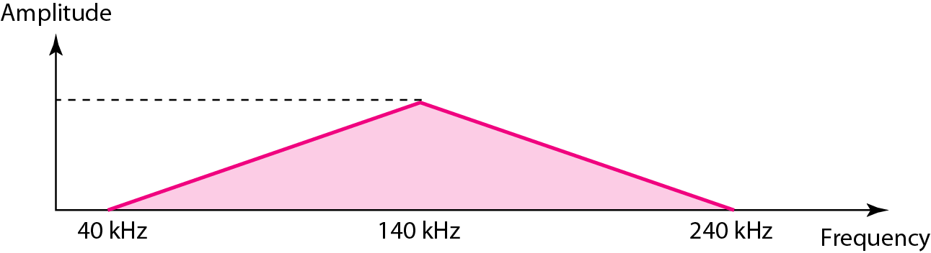
Figure The bandwidth for Example

Slide 21
DIGITAL SIGNALS
Information can also be represented by a digital signal.
For example
1 can be encoded as a positive voltage and a 0 as zero voltage.
A digital signal can have more than two levels.
In this case, we can send more than 1 bit for each level.

Slide 22
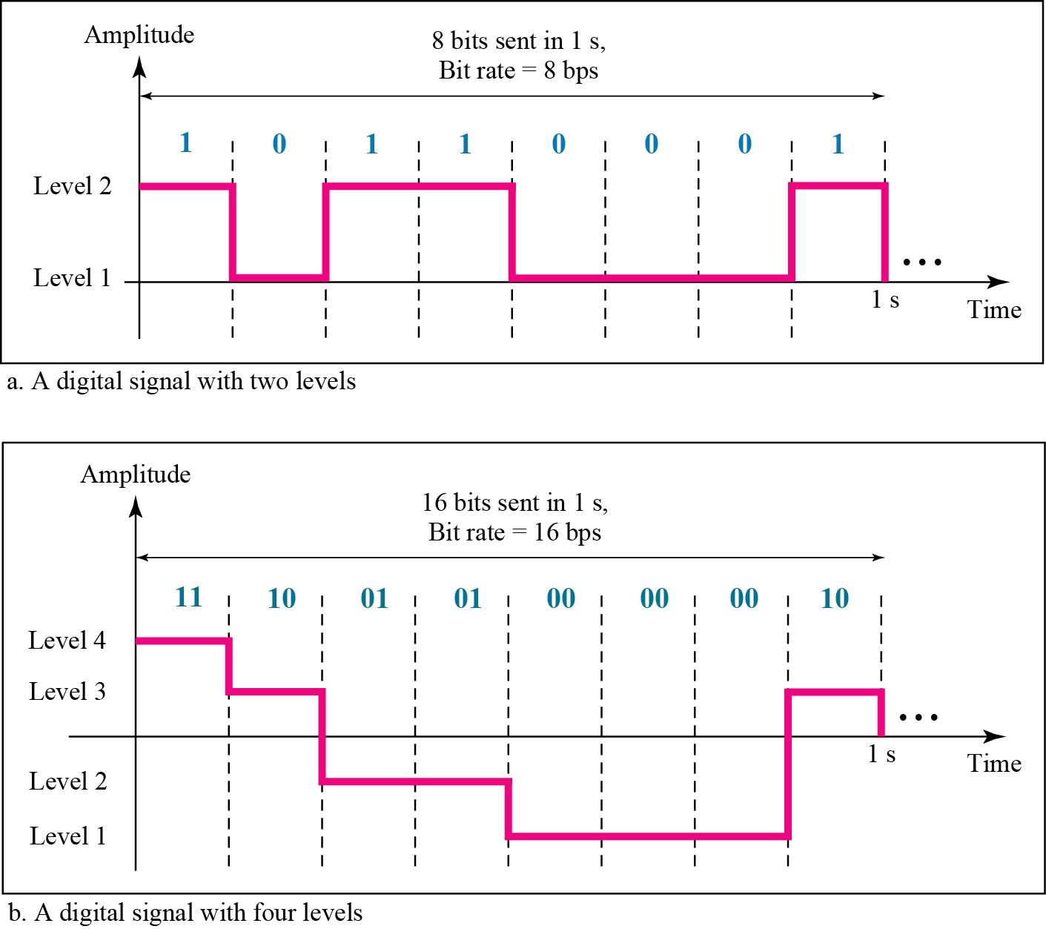
Figure Two digital signals: one with two signal levels and the other with four signal levels

Slide 23
A digital signal has eight levels.
How many bits are needed per level?
16
3
8
0

Slide 24
Ans B

Slide 25
Bit Rate
Most Digital Signals are non-periodic.
Therefore, period and frequency are not appropriate characteristics.
Bit rate is used.
Bit rate is number of bits sent in 1s. Expressed in bps.

Slide 26
A digitized voice channel is made by digitizing a 4-kHz bandwidth analog voice signal.
We need to sample the signal at twice the highest frequency (two samples per hertz).
We assume that each sample requires 8 bits. What is the required bit rate?
64 kbps
12 kbps
32 kbps

Slide 27
The bit rate can be calculated as

Slide 28
Bit Length
Bit length:
Distance one bit occupies on transmission medium.
Bit length= propagation speed* bit duration

Slide 29
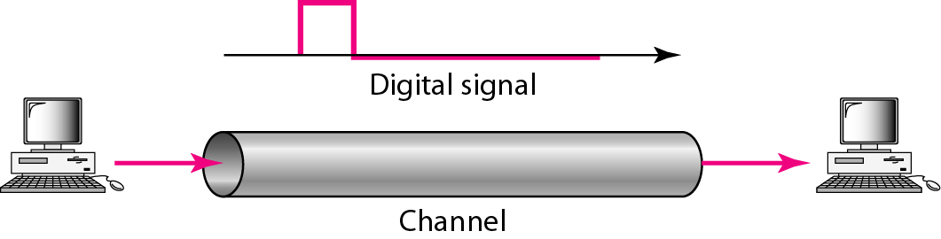
Figure Baseband transmission

Slide 30

Note
A digital signal is a composite analog signal with:
An infinite bandwidth.

Slide 31
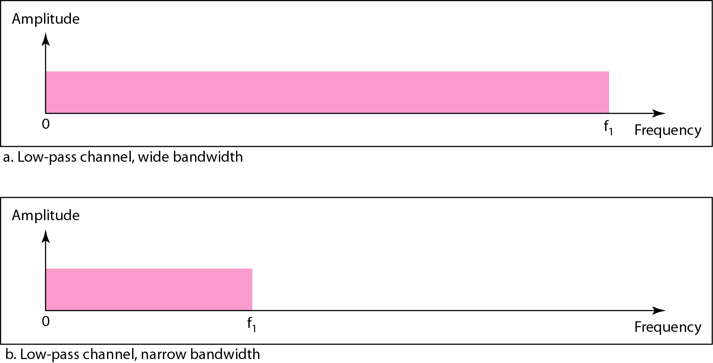
Figure Bandwidths of two low-pass channels

Slide 32
Baseband transmission of a digital signal that:
Preserves the shape of the digital signal
This is possible only if :
Have a low-pass channel with an infinite
or
very wide bandwidth.

Slide 33
In baseband transmission:
Required bandwidth is proportional to the bit rate
If need to send bits faster, need more bandwidth.
Bit rate is twice the bandwidth required.

Slide 34
Example
What is the required bandwidth of a low-pass channel?
If we need to send 1 Mbps by using baseband transmission?

Slide 35
Example
What is the required bandwidth of a low-pass channel if we need to send 1 Mbps by using baseband transmission?
Solution
The minimum bandwidth, is B = bit rate /2, or 500 kHz.

Slide 36
Example
We have a low-pass channel with bandwidth 100 kHz.
What is the maximum bit rate of this channel?
100 kbps
200 kbps
400 kbps

Slide 37
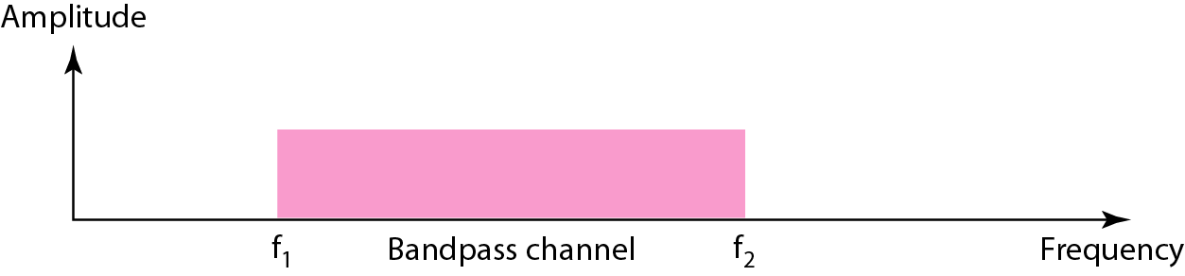
Broadband Transmission: Bandwidth of a bandpass channel

Slide 38
If the available channel is a bandpass channel:
Cannot send the digital signal directly to the channel
Need to convert:
Digital signal to an analog signal before transmission.

Slide 39
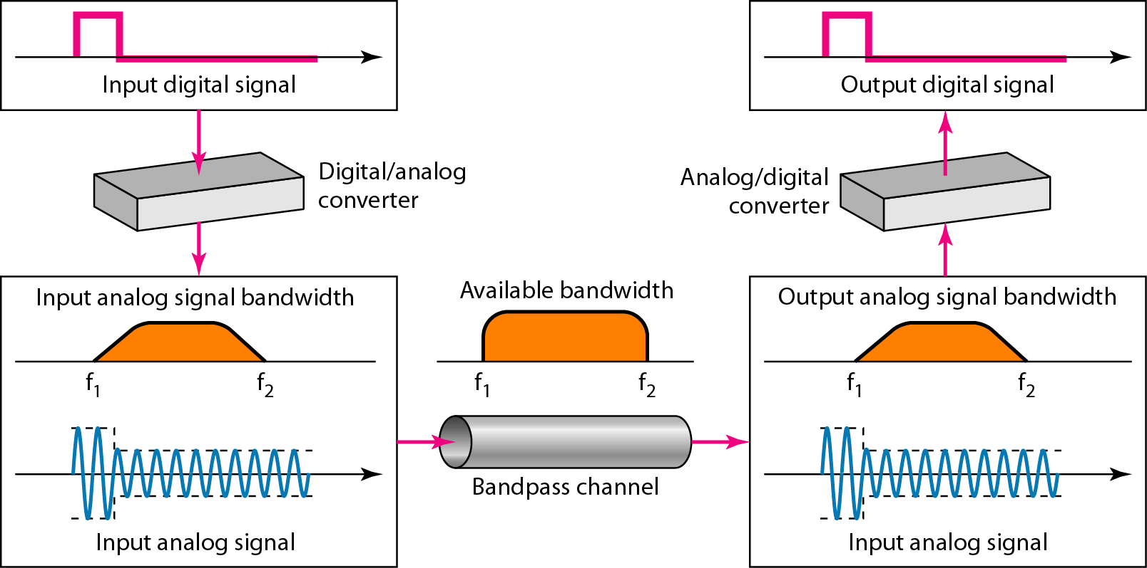
Figure Modulation of a digital signal for transmission on a bandpass channel

Slide 40
Example
An example of broadband transmission using modulation is
Sending of computer data through a telephone subscriber line

Slide 41
🌊 Oh no! To cross this river
(and save your data from leaking 💦),
match the tech-terms with their true powers!
🔹 Column A
- Bit rate
- Bit length
- Digital
- Baseband BW
🔹 Column B
- Speed of bits in 1s 🕐💨
- Space each bit takes 🛏️
- Goes on forever like bedtime stories 📖♾️
- Grows with bit speed 🚀📶
Notes:
Puzzle 1 Answers:
- Bit rate → Speed of bits in 1s
- Bit length → Space each bit takes
- Digital → Goes on forever like bedtime stories (infinite bandwidth)
- Baseband BW → Grows with bit speed
Justification:
Bit rate = bits per second; Bit length = physical distance of one bit.
Digital signals theoretically have infinite bandwidth.
Baseband bandwidth increases with bit rate (BW = bit rate / 2).

Slide 42
🚣‍♂️ Another river!
This time it's filled with sine
waves and spikes.
Match the terms to stay dry!
🔹 Column A
- Fourier
- Composite
- Freq. Dom
- Bandwidth
🔹 Column B
- Turns waves into tiny beats 🎧
- Group of wave friends 🎊
- Spiky signal spectrum 🌊📊
- Highest minus lowest note 🎼📏
Notes:
Puzzle 2 Answers:
- Fourier → Turns waves into tiny beats
- Composite → Group of wave friends (sine mix)
- Freq. Dom → Spiky signal spectrum (frequency view)
- Bandwidth → Highest minus lowest note (range)
Justification:
Fourier: analysis technique to break signal into sine waves.
Composite: combination of multiple sine waves.
Frequency domain: represents sine components as spikes.
Bandwidth: frequency range = f_high - f_low.

